Slide 1

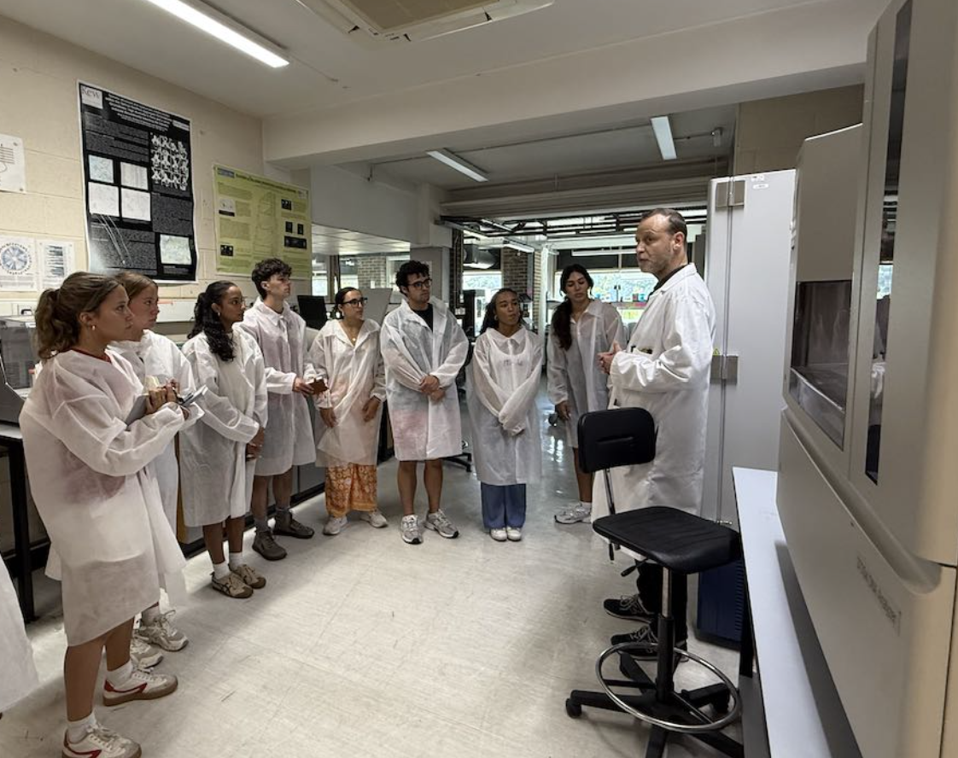
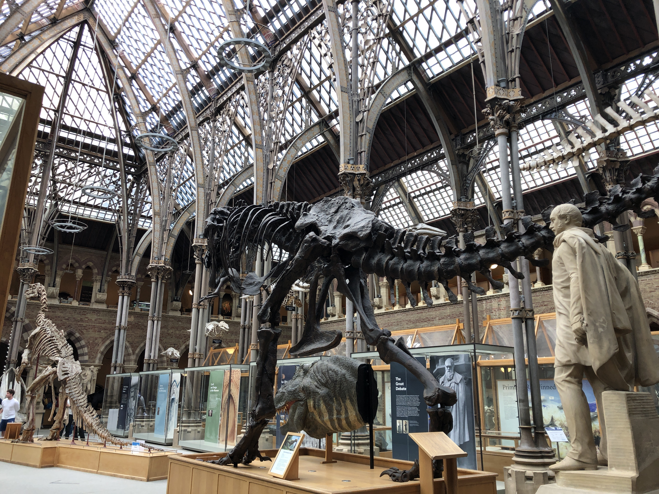
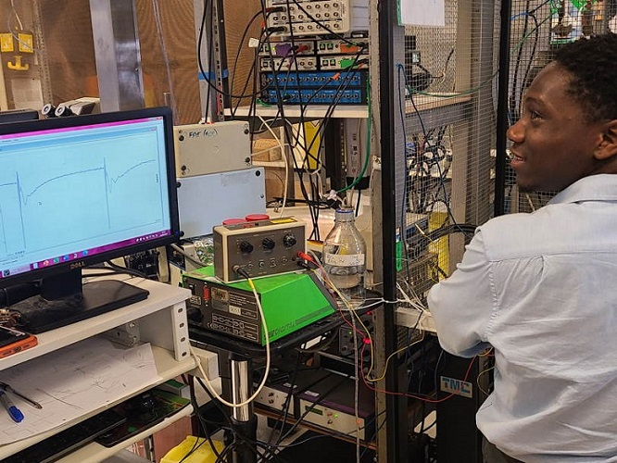
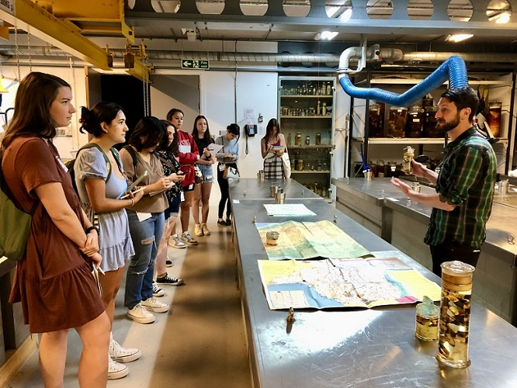
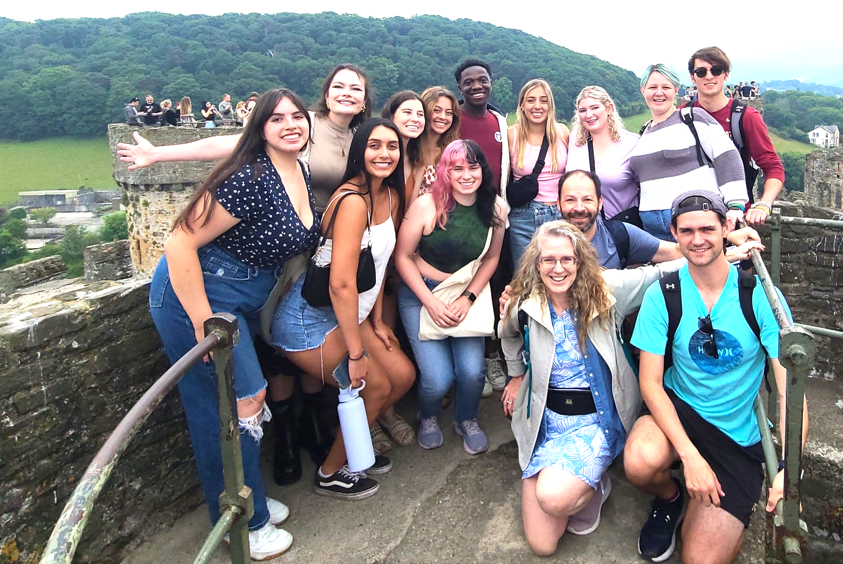
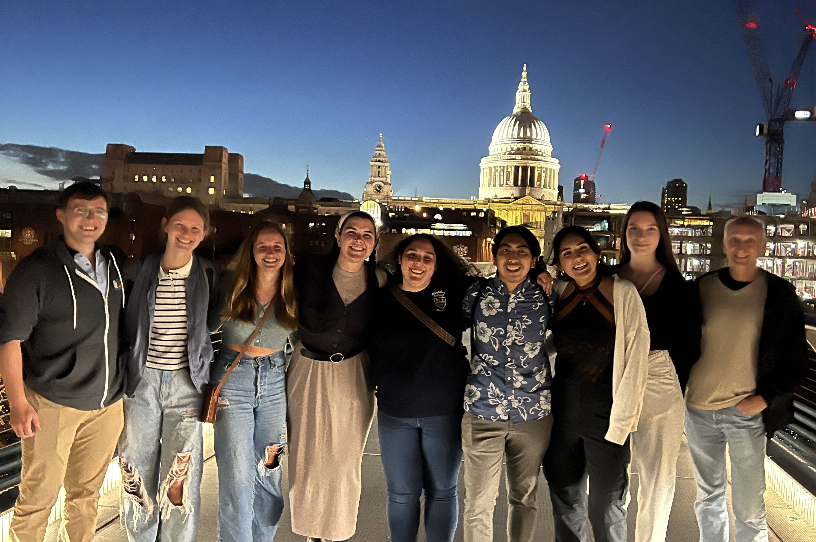
Biology in London

Slide 2
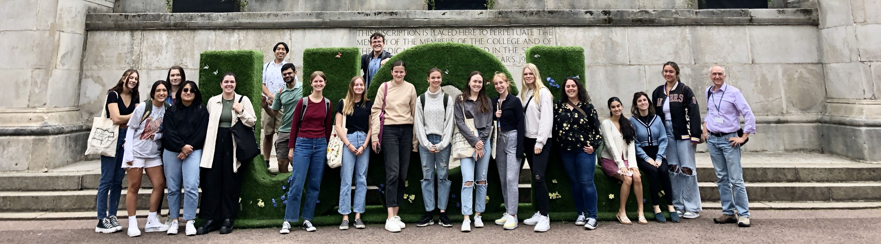
Biology in London Program Summer 2027
A departmental program targeted to majors during the summer in London
Two upper division classes, offered concurrently over six weeks (June 17 – July 25)
Open to non-majors as well

Slide 3
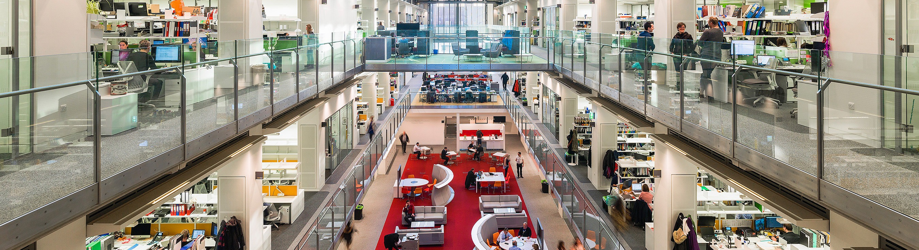
Biology in London Program Summer 2027
Why study biology in London?
Live in a safe, vibrant city in a foreign country
Make connections & build a community with a diverse group of friends
Create core memories of another culture and expand your global perspective
Satisfy graduation requirements (2 electives)
Small class sizes and more personal interaction with teachers
Immersive experiences and resources not available in Florida (esp. museums)
The Francis Crick Institute

Slide 4
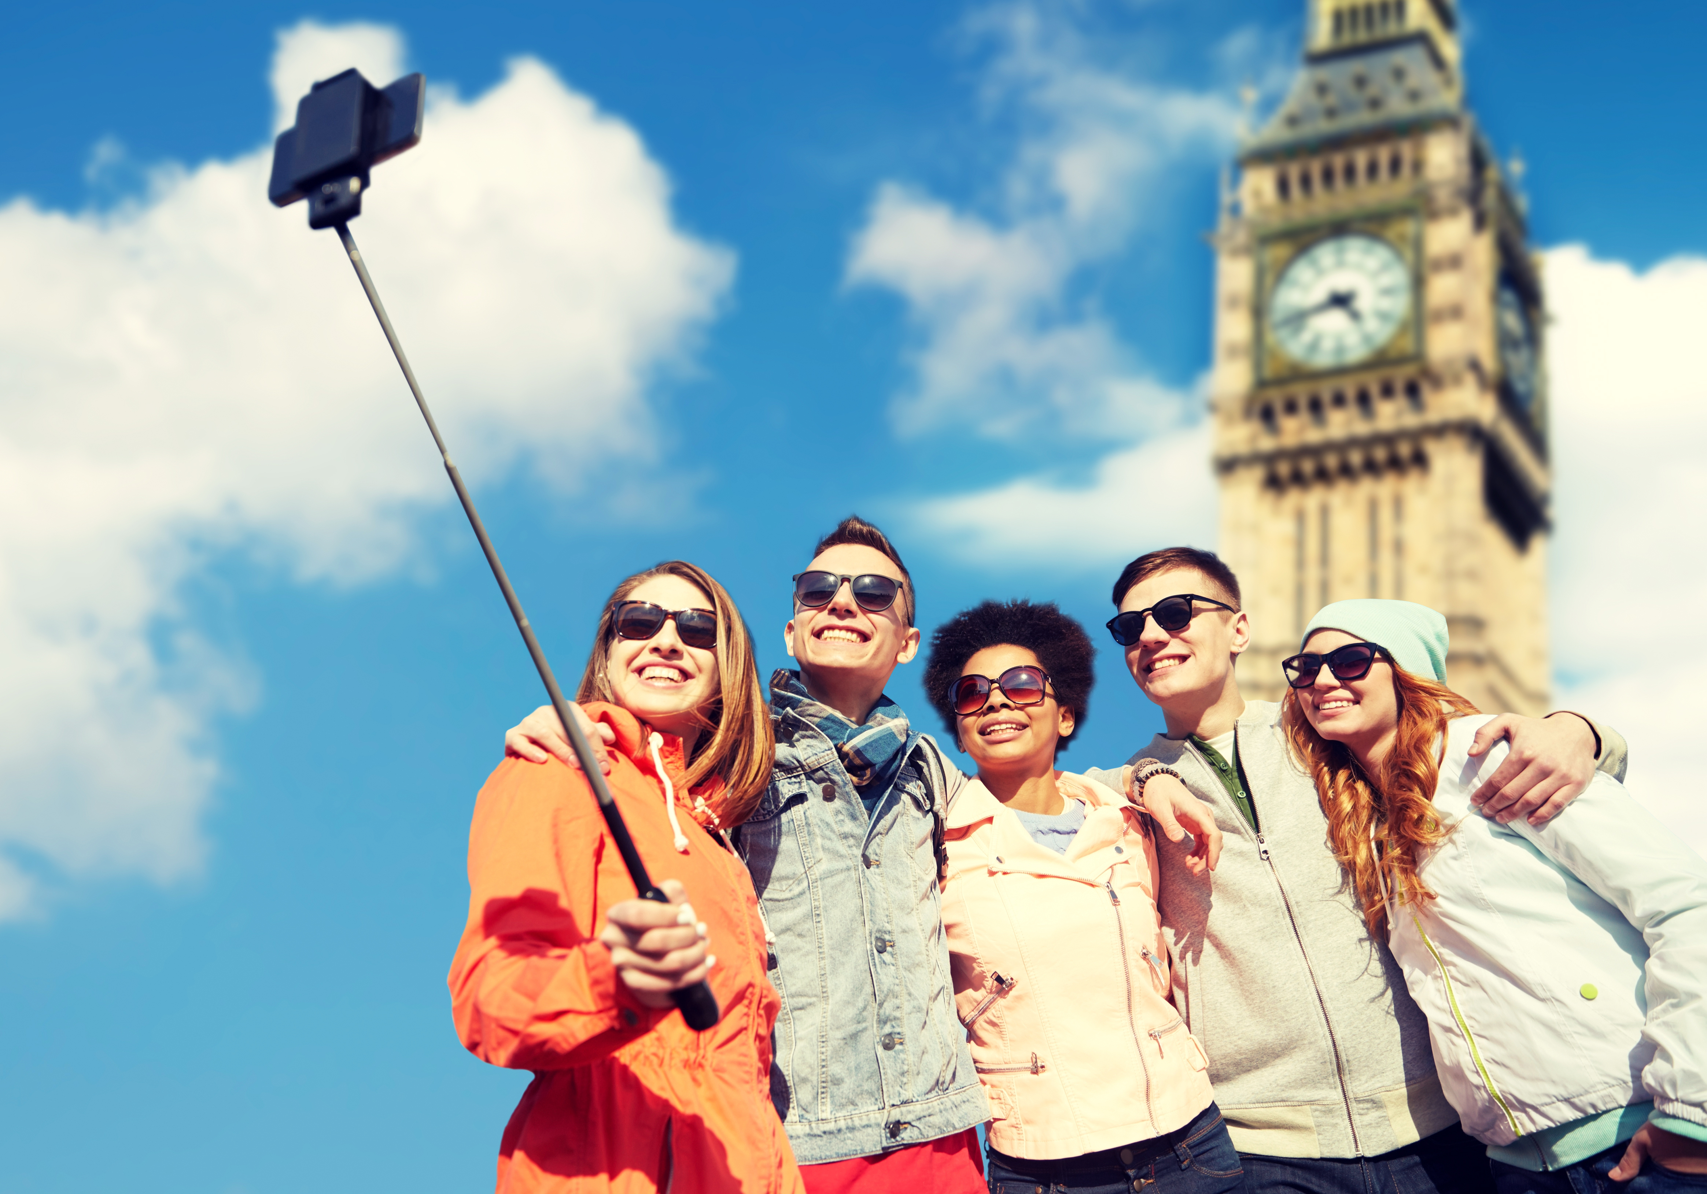
The London Experience

Slide 5
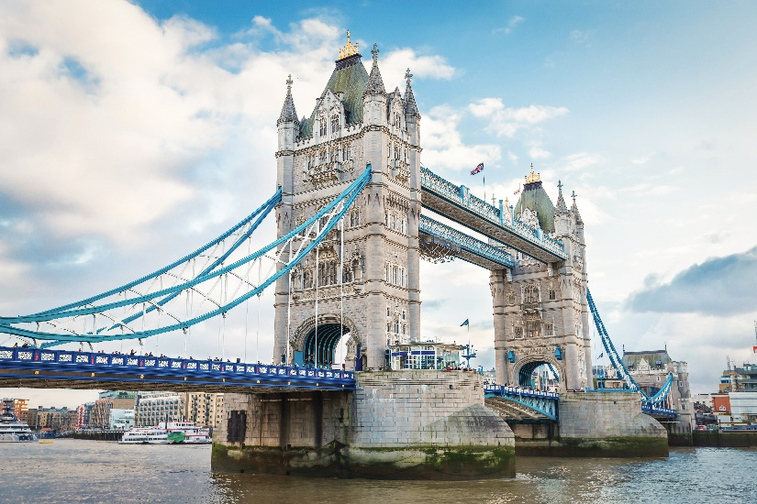
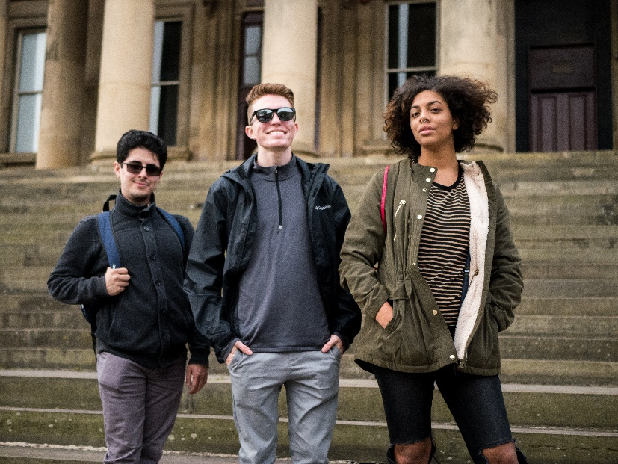

Florida State University’s International Programs is proud to celebrate more than 65 years of experience in international education and is a nationally recognized leader in the field of study abroad programs.

Slide 6
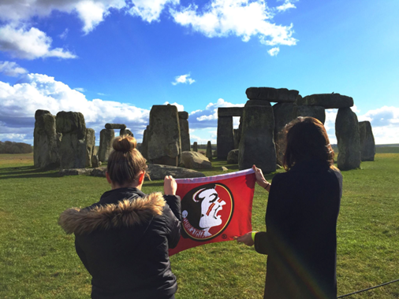
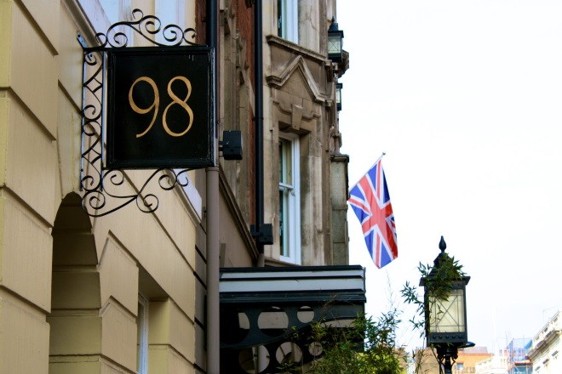
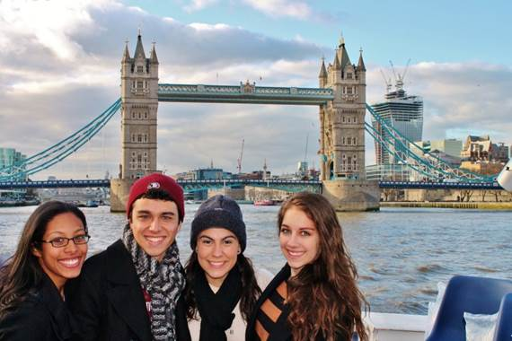
London Study Center
Centrally located, two blocks from the British Museum and University College, London
Walk to Covent Garden, Trafalgar Square, and Houses of Parliament
Lots of FREE cultural events through the Broad Curriculum social calendar, including weekend excursions to cities such as Lake District, Bath or York, plus day trips and plays.

Slide 7
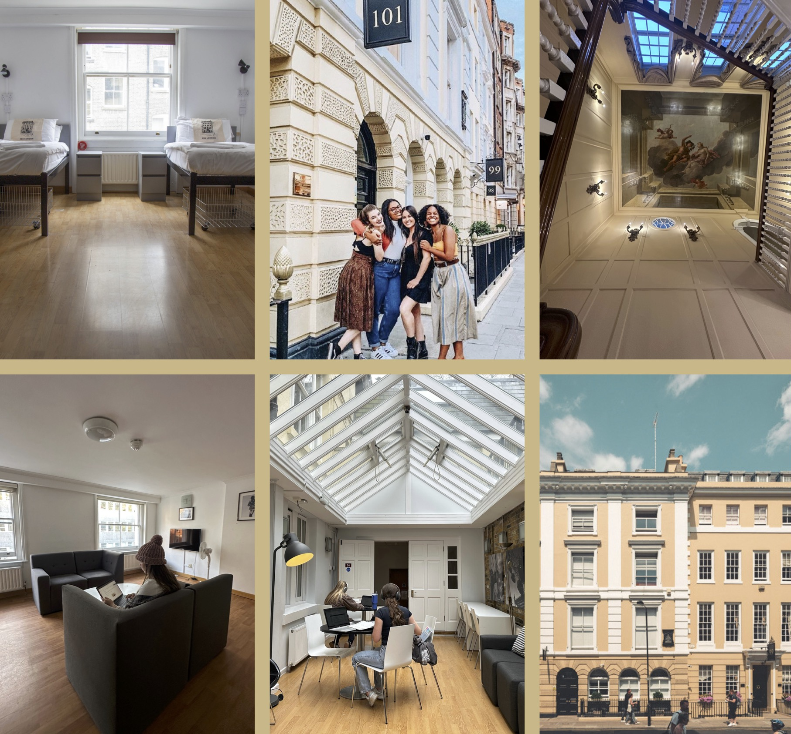
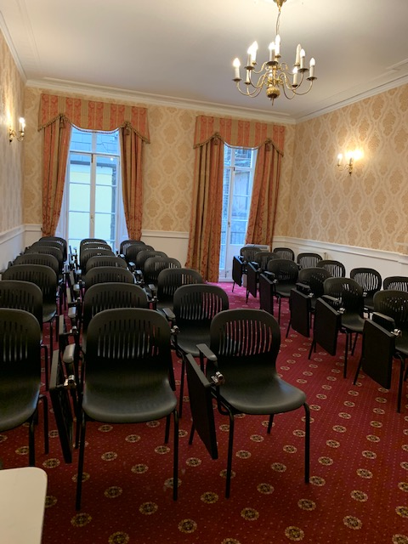
London Study Center
Student lounges & library
Free laundry facilities
Shared flat-style apartments with full kitchens,
Shared bathrooms, and living space
24/7 security & pastoral care

Slide 8
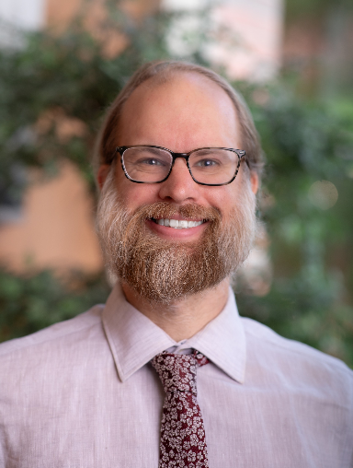
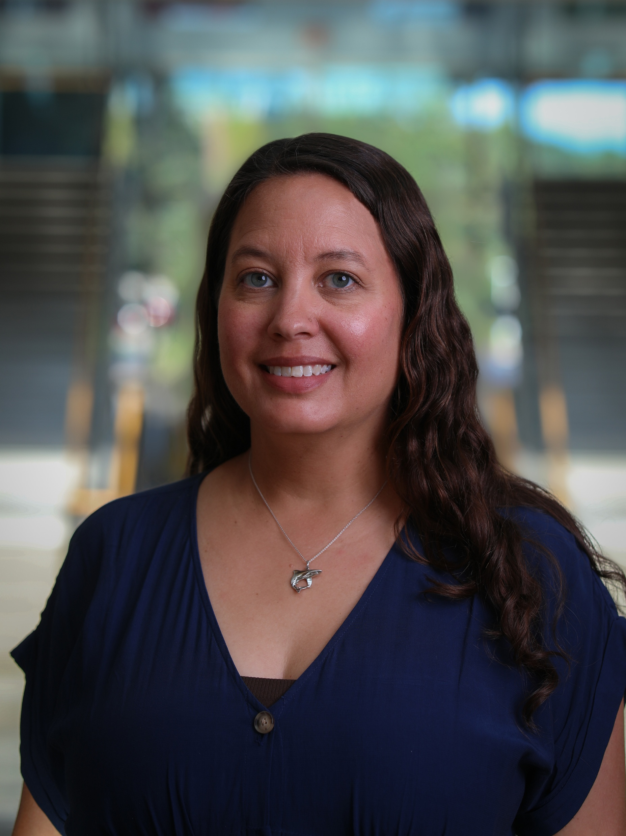
Biology in London Program Summer 2027
Classes to be offered:
BSC 4933 The Natural History of Monsters: Biology, Folklore, and the Origin of Gothic Horror (3 credit hours)
Taught by Dr. David McNutt
ZOO 4454C Biology of Fishes (3 credit hours)
  Taught by Dr. Johanna McNutt

Slide 9
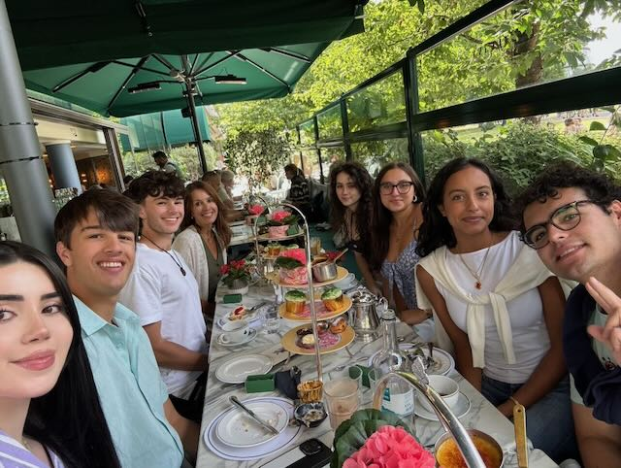
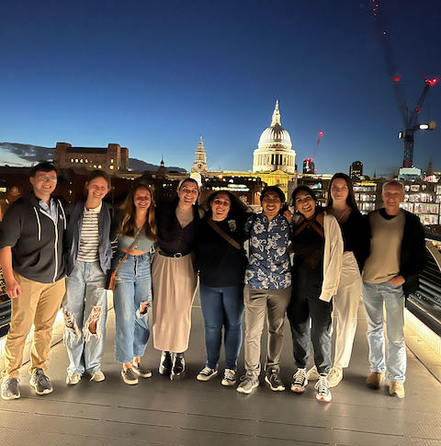
Biology in London Program
The London Experience: Cultural Calendar
Afternoon tea
After the farewell Shakespeare play

Slide 10
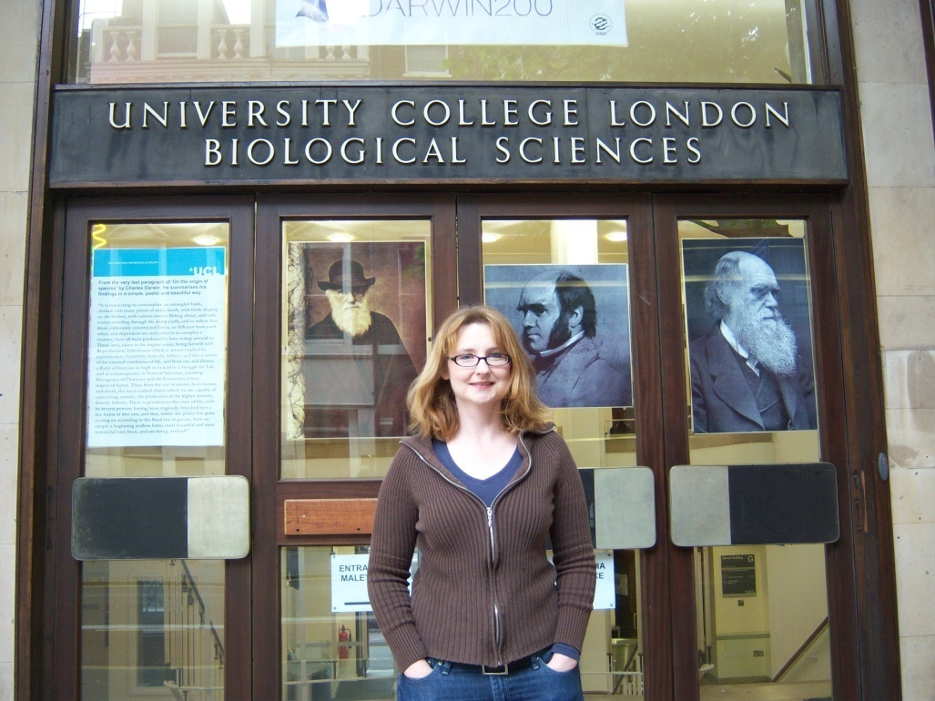
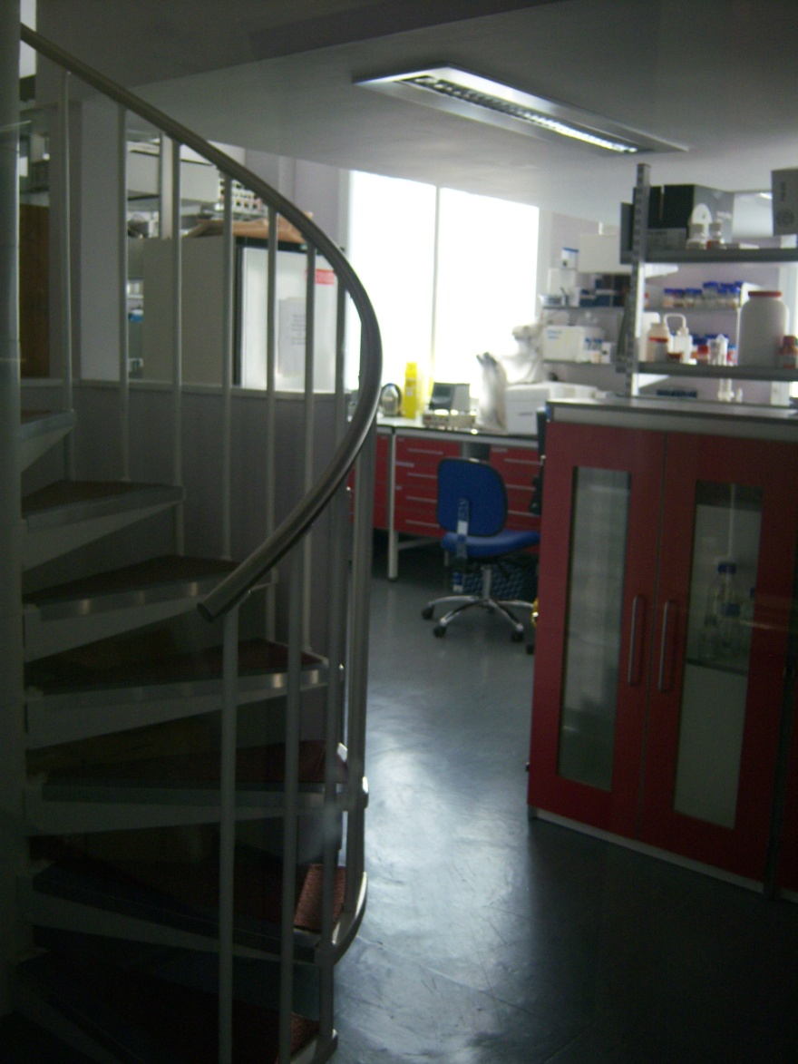
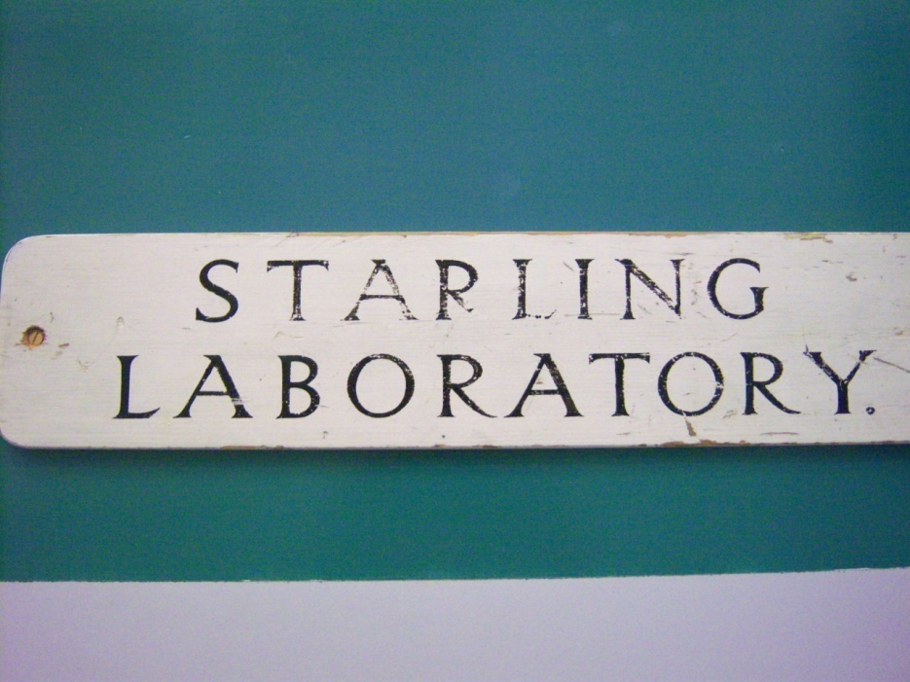
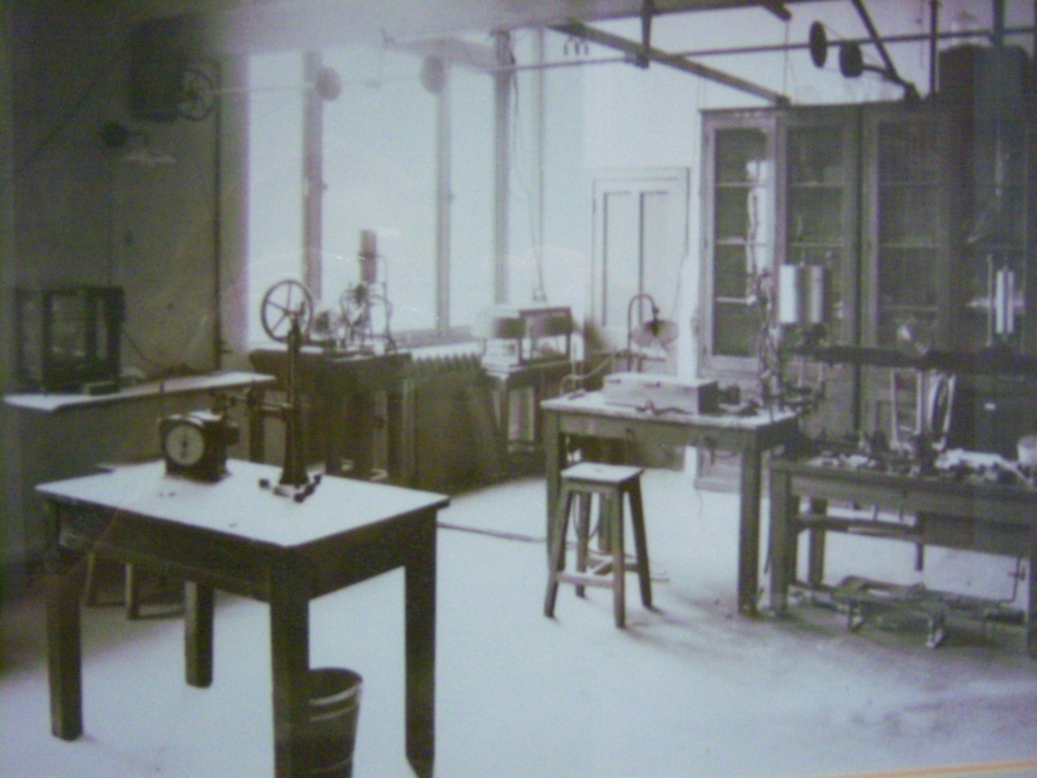
Biology in London Program
The London Experience
Visit to University College, London

Slide 11
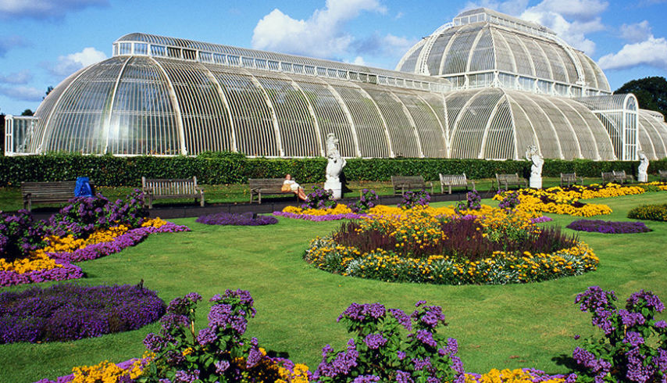
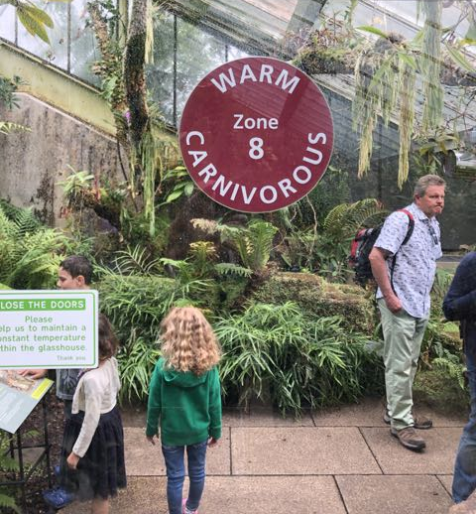
Biology in London Program
The London Experience:
Royal Kew Gardens

Slide 12
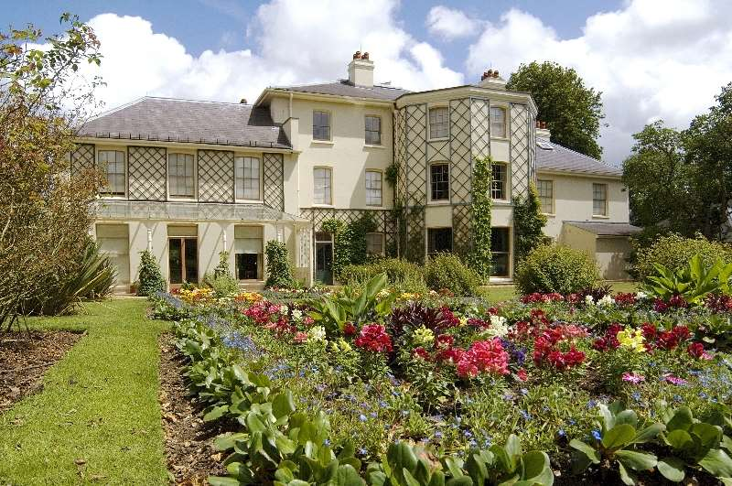
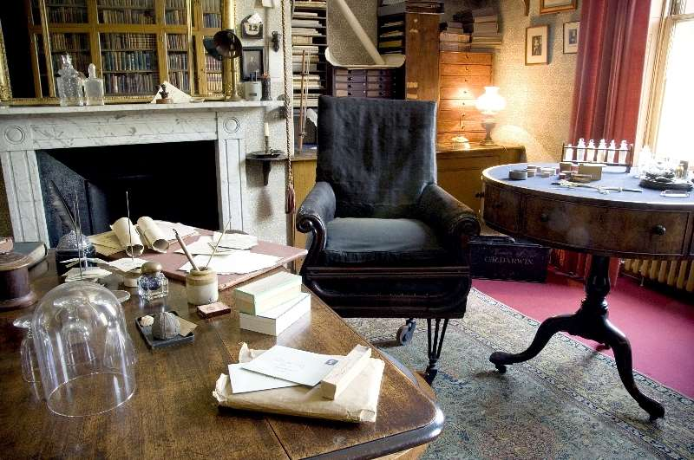
Biology in London Program
The London Experience: An historical perspective
Darwin’s House (Down House)

Slide 13
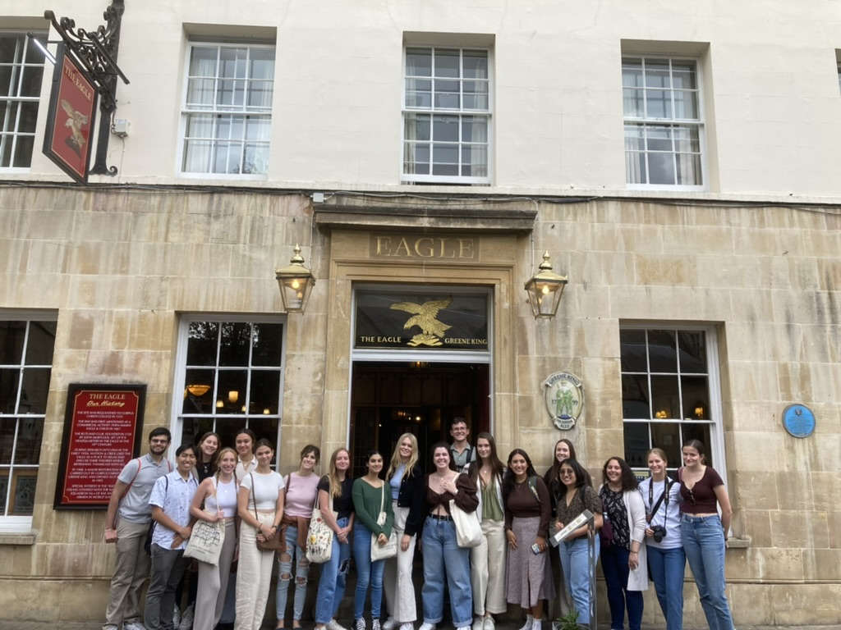
Biology in London Program
Cambridge: A guided tour with a scientific historical perspective
The Eagle Pub

Slide 14
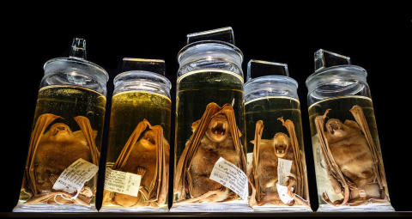
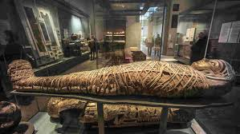
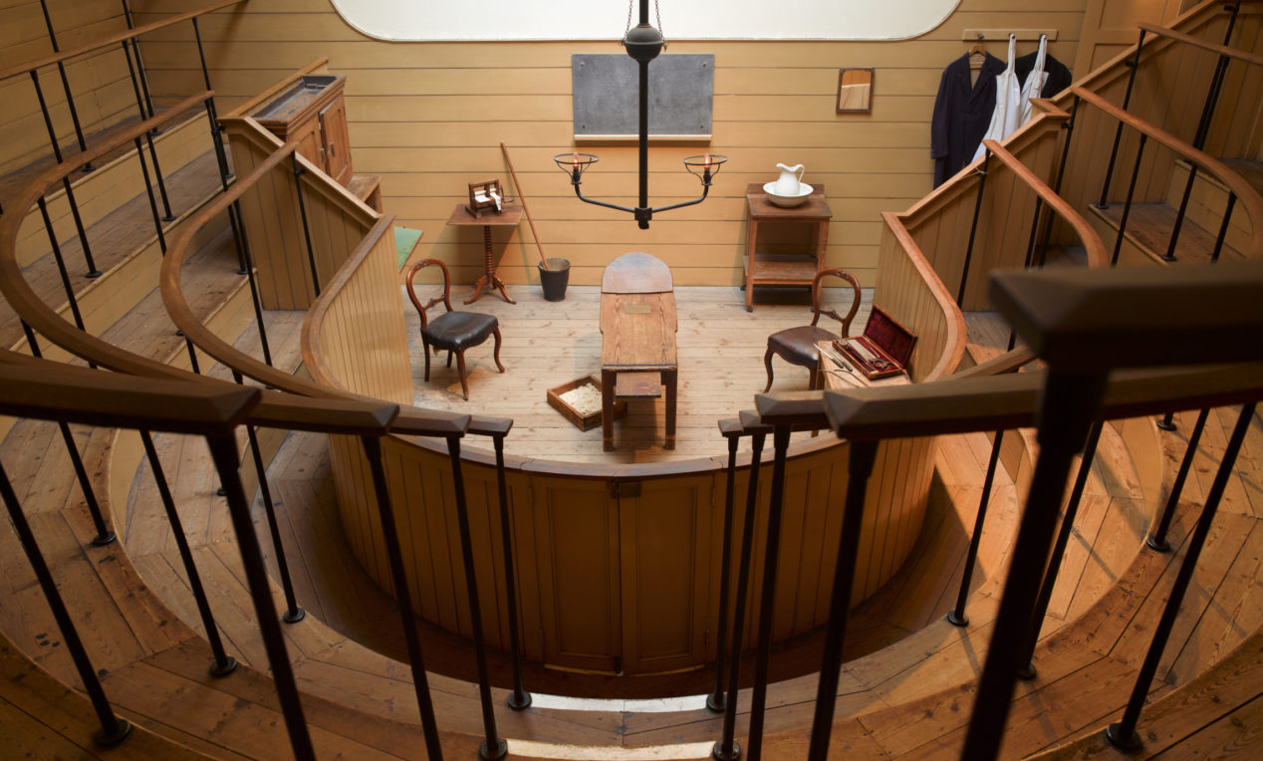
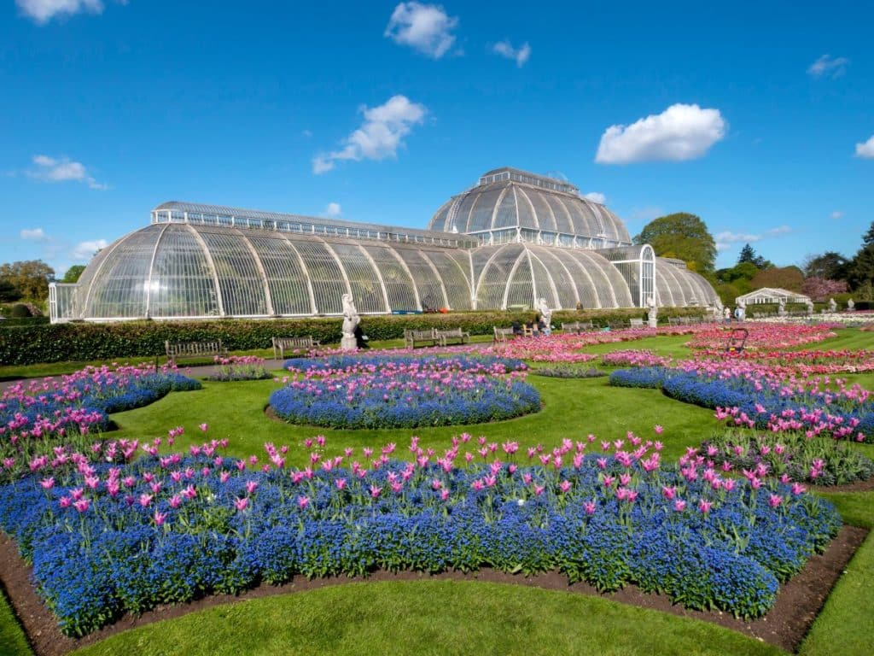
Biology in London Program Summer 2026
BSC 4933 The Natural History of Monsters
Many well-known monsters in film and literature were created in 19th century England and are motivated by biological phenomena. Students will visit museums, gardens, and cultural landmarks to learn how Gothic horror characters such as Frankenstein’s monster, Dracula, werewolves, witches, and mummies were inspired by real-life organisms and scientists. Topics will include the scientific study of resurrection, immortality, preservation, disease outbreaks, medicinal plants, and genetic disorders.
  Hunterian Museum
  Royal College of Physicians Gardens
  British Museum
  Natural History Museum
  Old Operating Theater
  Kew Gardens
  Plague Tour and Bram Stoker Tour

Slide 15
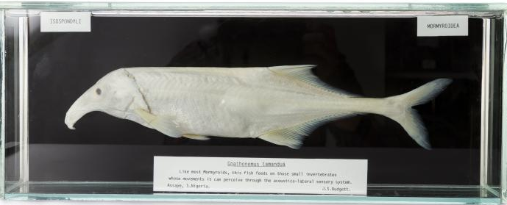
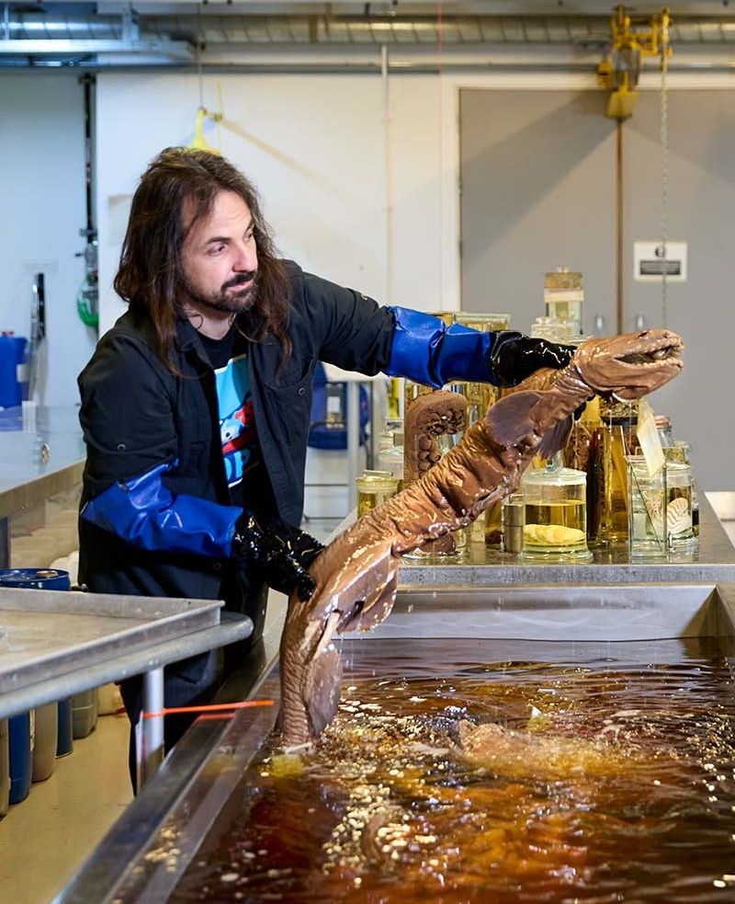
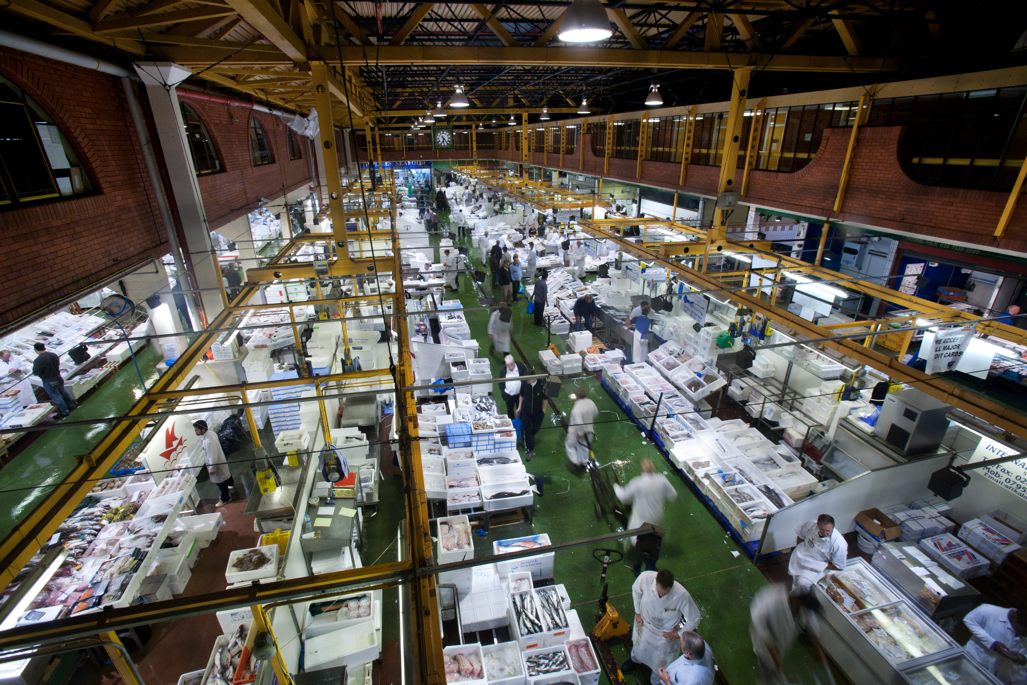
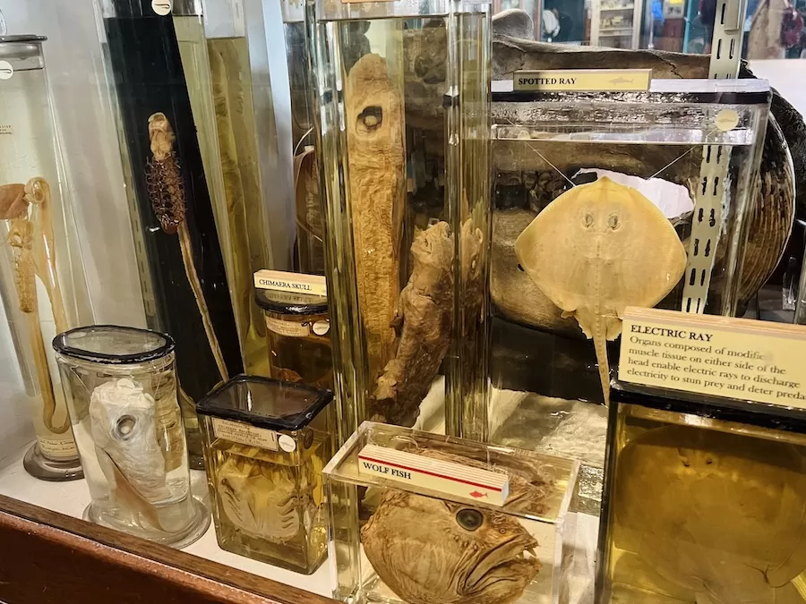
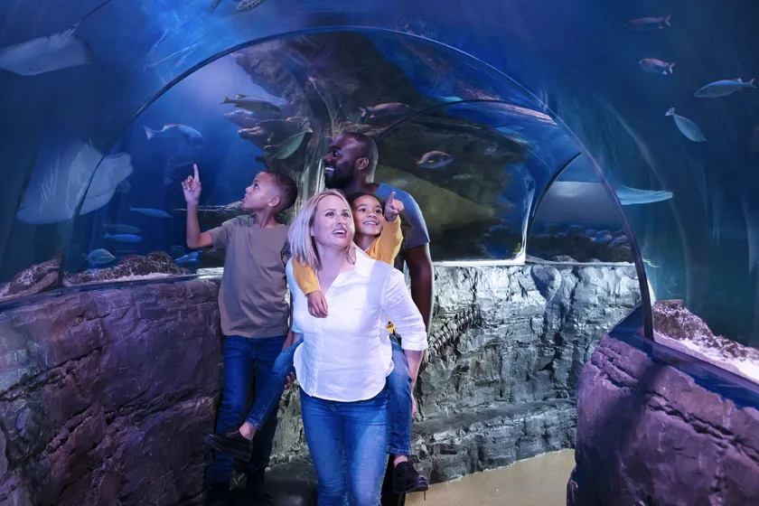
Biology in London Program Summer 2027
ZOO4454C Biology of Fishes
The fishes are the most diverse group of vertebrates on planet earth. This course invites students to investigate the systematics, morphology, ecology, behavior, physiology, and life history of fishes through diverse and historically important museum specimens and aquarium observations.
  Billingsgate Market
  Cambridge Museum of Zoology
  Darwin’s home (Down House)
  Grant Museum of Zoology
  Linnean Society
  Natural History Museum
  SEA LIFE London Aquarium
Notes:
Private tour of the collections, Natural History Museum

Slide 16
Biology in London Program Summer 2027
Program Dates and Info
No prerequisites required beyond BIO 2010/L and BIO 2011 (lecture only) with C- or better, or being enrolled by the application date in early Spring.
Program Application Open: October 14, 2026 ($100)
IP Scholarship Application Due: December 30, 2026
Commitment Fee Due: January 12, 2027 ($1,500, refundable)
Final Payment Date: February 9, 2027
London! June 17 – July 25, 2027
*Early application is advisable as program enrollment is limited and acceptances are offered on a rolling basis.

Slide 17
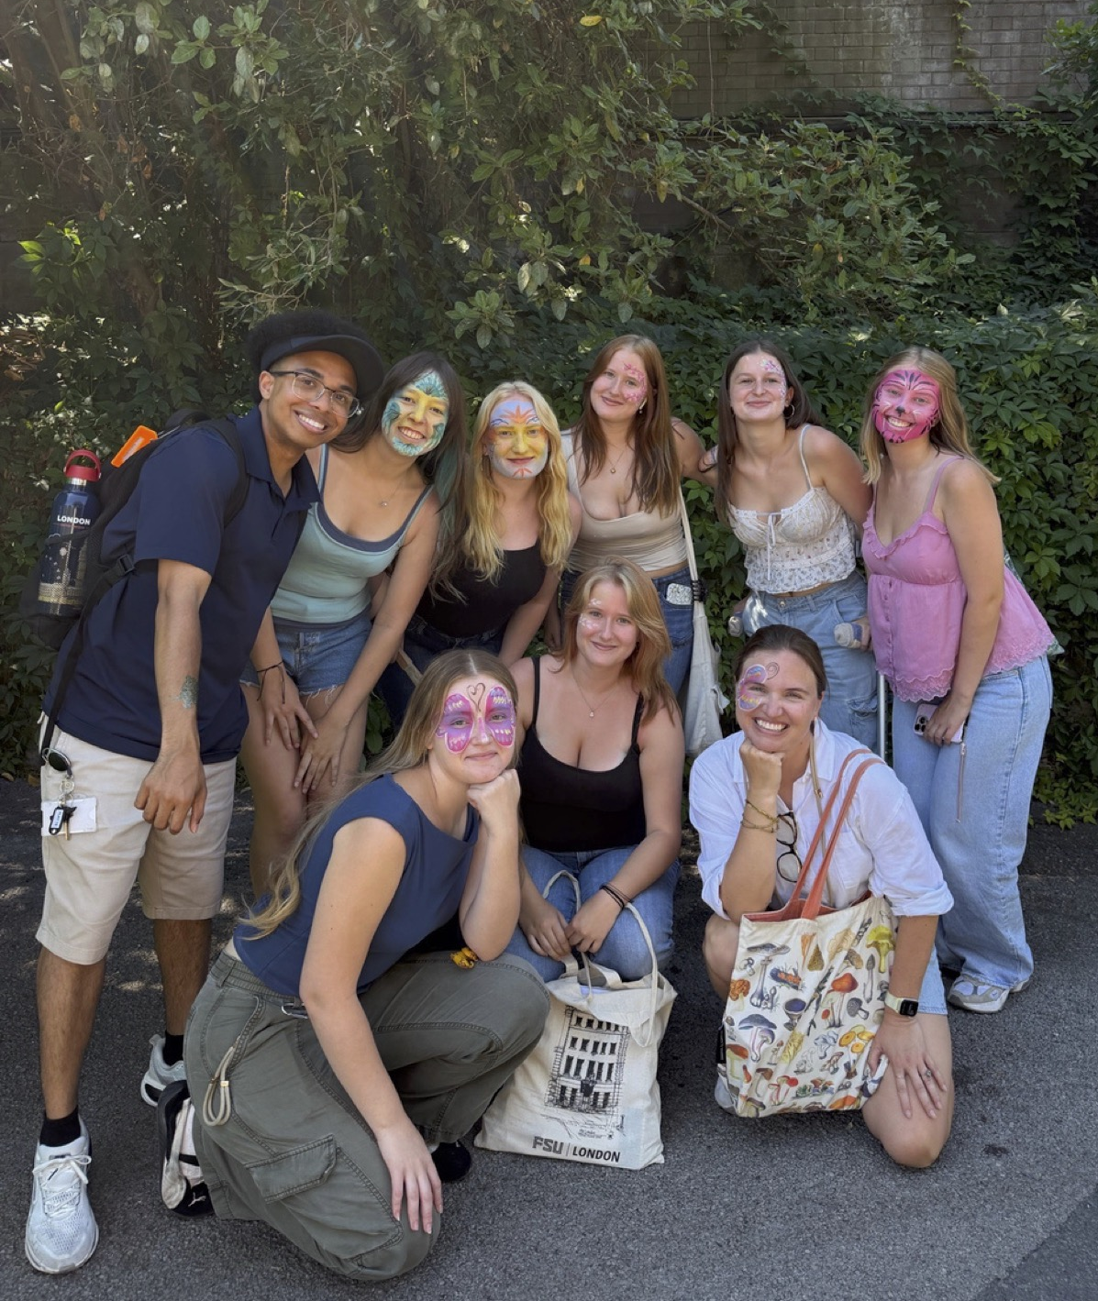
Biology in London Program Summer 2027
Program Fees Include
Instructional costs for 6 credits
Housing
£100 worth of meal vouchers
Transport card for class and program-organized
excursions
Program-planned excursions/groups activities
Full-time academic support
On-site administrative and pastoral support
International health insurance
Program Fees Do NOT Include
Round-trip international airfare
Passport
Electronic Travel Authorization (ETA)
Food (except as noted above)
Personal travel/activity money
Course-related fees (e.g. books & supplies)

Slide 18


Slide 19
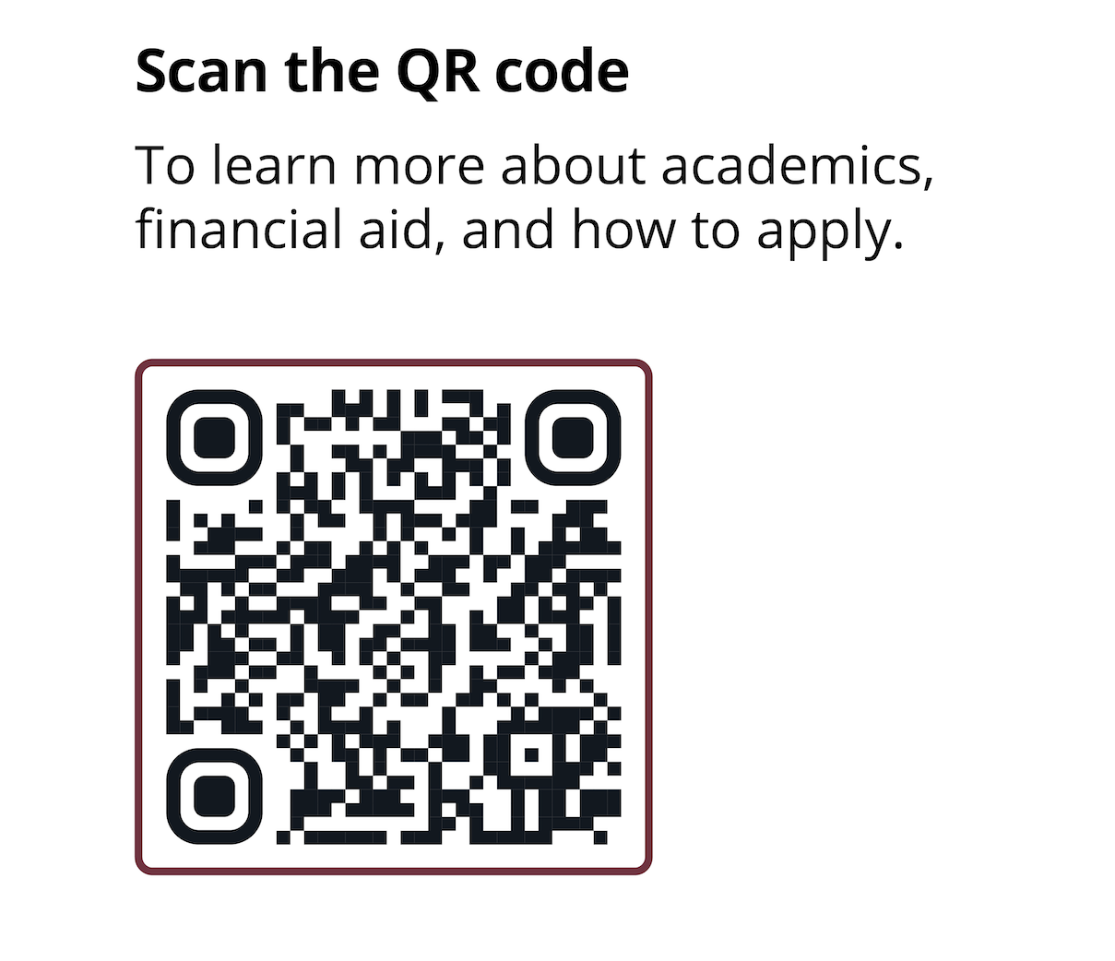
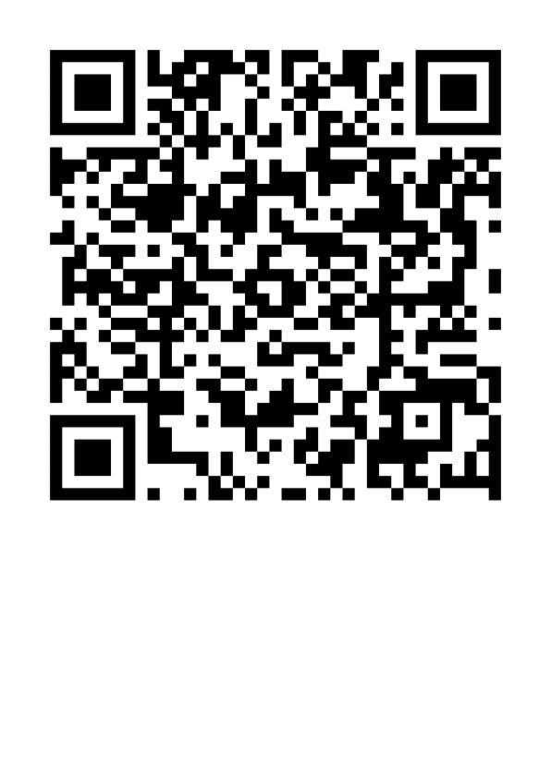
Biology in London Program Summer 2027
For more information:
Dr. Scott Steppan, Bio in London Coordinator (steppan@bio.fsu.edu)
  Instructor: Dr. David McNutt (dmcnutt@bio.fsu.edu)
  Instructor: Dr. Johanna McNutt (jmcnutt@bio.fsu.edu)
Biology Dept. Advising office (advisor@bio.fsu.edu)
International Programs (international.fsu.edu)
Nadya Rosario (Program Coordinator, ngrosario@fsu.edu)
Megan Glogowski (Program Coordinator, mglogowski@fsu.edu)
International Programs Advising (IP-AcademicAdvising@fsu.edu)
International Programs Financial Aid (IP-FinancialAid@fsu.edu)
https://international.fsu.edu/ or email IP-Info@fsu.edu

Slide 20
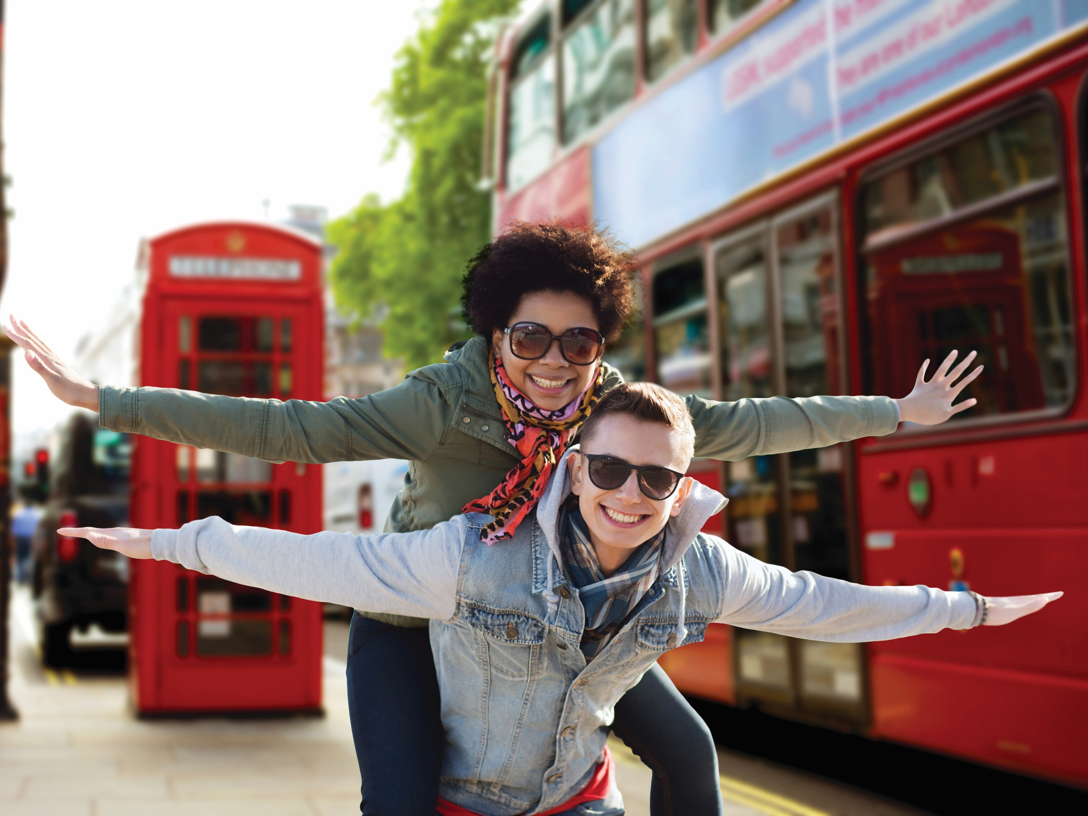

Biology in
London
Notes:
Introductions

